Slide 1
IOT LAB Group No. 3 32C Topic: Smart Irrigation

Slide 2
IOT LAB
2nd SEMESTER LAB
NAME | UID
Harsh Tandiya | 20BCS9693
Rohan Ghosh | 20BCS9671
Pushp Ranjan | 20BCS9692
Paras Guglani | 20BCS9403

Slide 3
Smart Irrigation System
In the case of traditional irrigation system water saving is not considered. Since, the water is irrigated directly in the land, plants under go high stress from variation in soil moisture, therefore plant appearance is reduced. The absence of automatic controlling of the system result in improper water control system. At present there is emerging global water crisis where managing scarcity of water has become a serious job.

Slide 4
ABSTRACT
Our Goal is develop an automated irrigation mechanism which turns the pumping motor ON and OFF on detecting the moisture content of the earth using the soil moisture sensor without the intervention of human. The benefit of employing these techniques is to decrease human interference and it is quite feasible and affordable. This Smart irrigation system project is using an arduino micro-controller, that is programmed to collect the input signal according to moisture content of the soil and its output is given to the op-amp that will operate the pump.

Slide 5
ADVANTAGES OF Smart Irrigation System
Automation: Aside from meeting with the irrigation contractor, paying the bill, and flipping a switch – an automatic system requires no manual exertion.
Cost effective: Automatic irrigation systems provide water to ground exactly where and when it is needed, which cuts down utility bills significantly.
Eco Friendly: A smart irrigation controller can help the planet by conserving our water resources.

Slide 6
Apparatus
Arduino UNO
Soil Moisture sensor
Relay
Jumper Wires
Motor

Slide 7
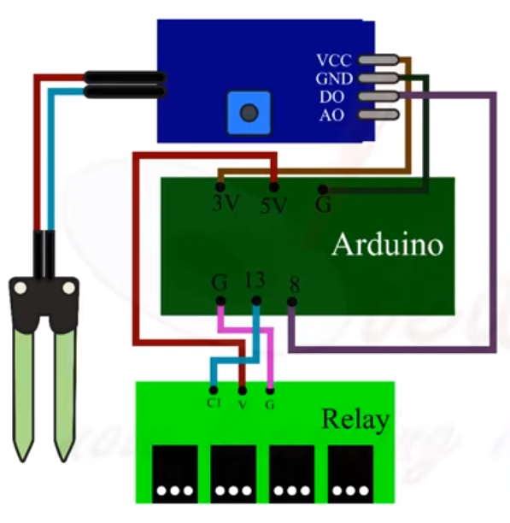
Circuit Diagram

Slide 8
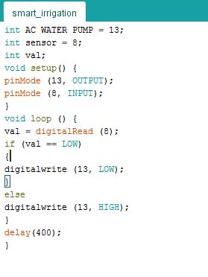
Source code

Slide 9
Conclusion
The smart irrigation system implemented is cost effective for optimizing water resources for agricultural production. The proposed system can be used to switch on/off the water sprinkler depending on the soil moisture levels thereby making the process simpler to use. Through this project it can be concluded that there can be considerable development in irrigation with those of IOT and automation. Thus this system is a solution to the problems faced in the existing process of irrigation.

